Slide 1


Slide 2
Massively Open Online Courses (MOOCS)
Past, Present, and Future
Dr. Charles Severance
University of Michigan School of Information

Slide 3
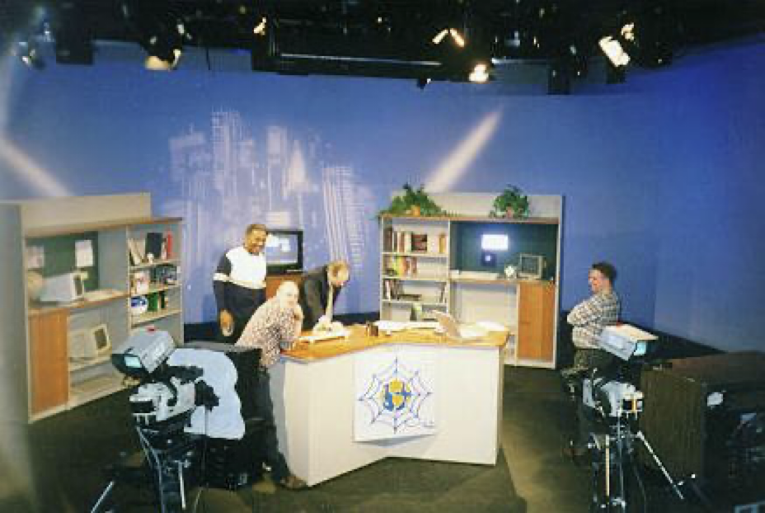
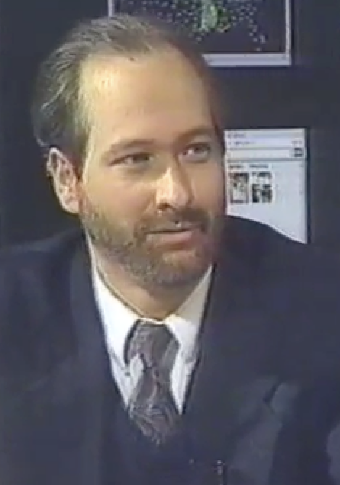
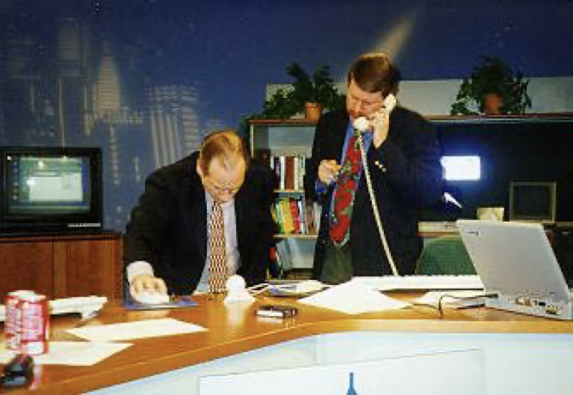
TV "Personality"
Sponsored and distributed by Cable television networks
East Lansing, MI
Promote Cable Modems
Internet:TCI (1996-97)
Nuthin' but Net (1998-99)

Slide 4
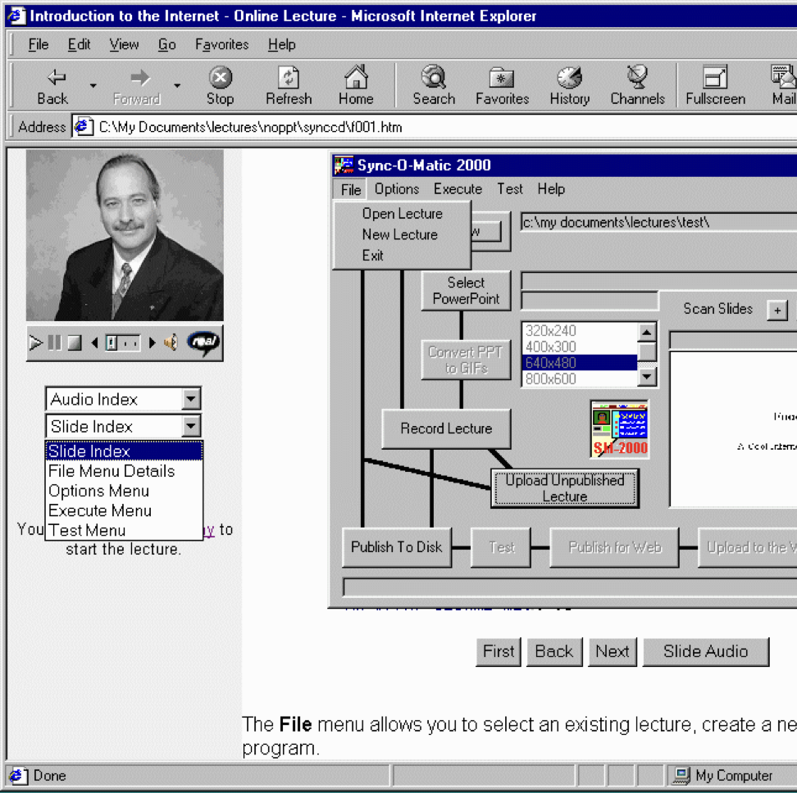
Sync-O-Matic
Michigan State University
First fully online streamed college course
Used RealAudio and 14.4 modems
Windows / Visual Basic
1997 - 1999

Slide 5
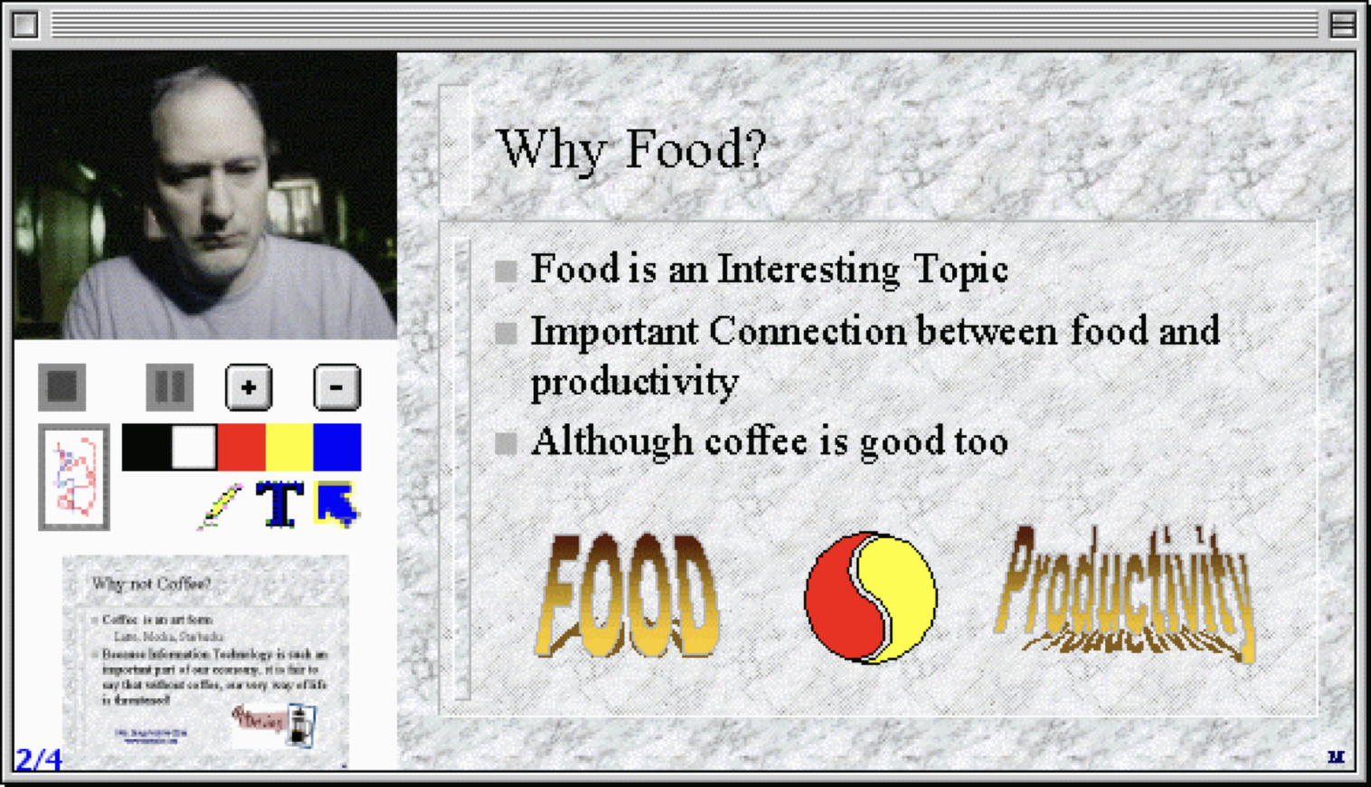
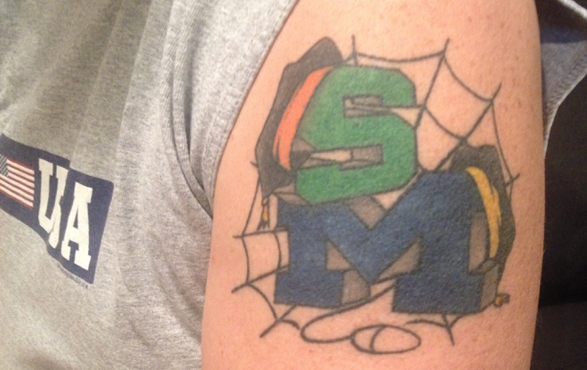
Clipboard 2000
University of Michigan
Complete rewrite – Apple / Quicktime / RealBasic
Taught C++ (EECS 280)

Slide 6
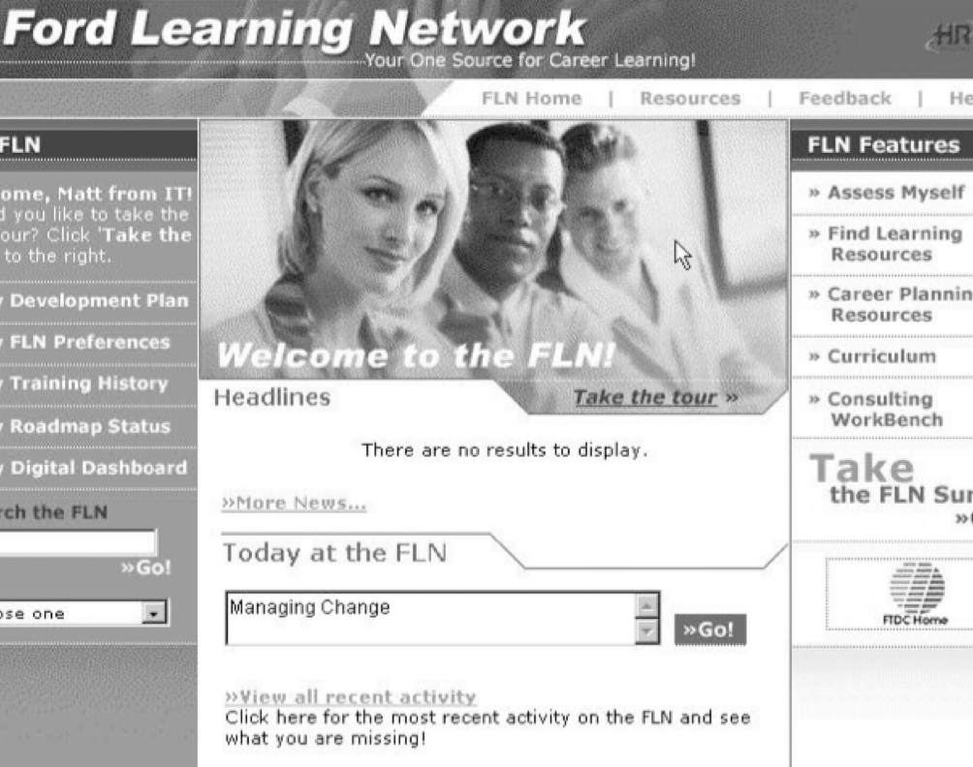
FLN (2001)
Worked at a web-based education startup
Ford
General Motors
Pepsi
Innovative System
Analyze activities and results – adjust search results
Personal learning Roadmap

Slide 7
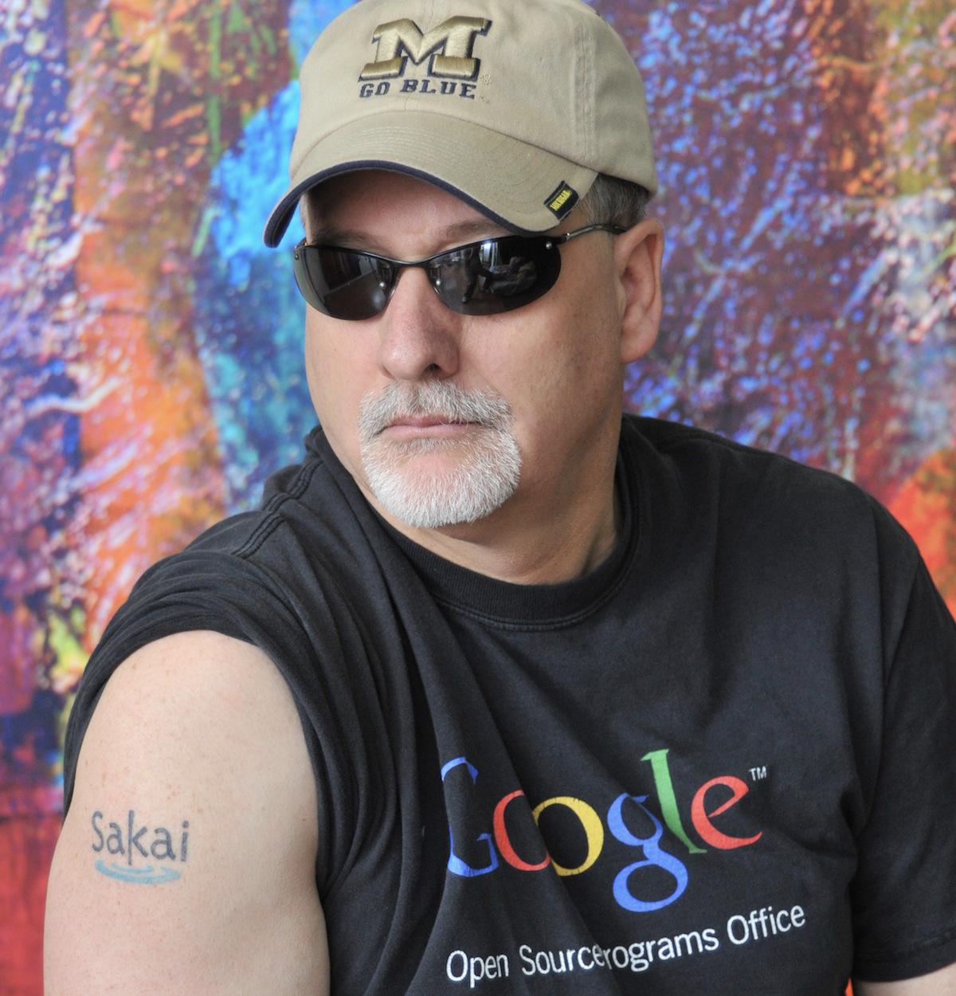
Sakai (2002- )
Back to University of Michigan
Open Source Learning Management System
Written in Java
Challenged the established vendors
Blackboard
WebCT
Angel
Desire2Learn
Reached 6% Market Share
Canvas borrowed the Sakai design in 2008
Long story (that continues)

Slide 8
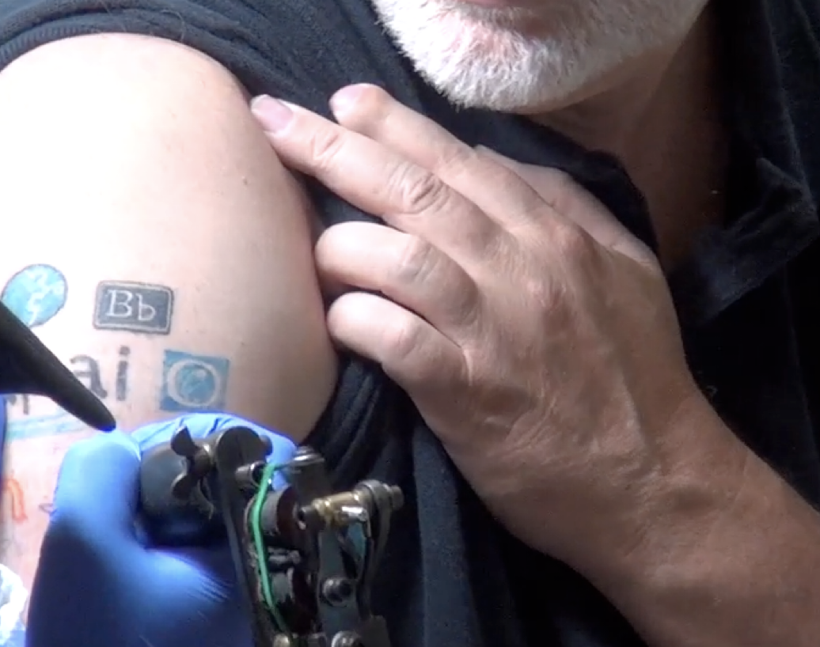
Learning Tools Interoperability (2004 - )
Sakai used our influence to develop LMS interoperability standards
Learning Tools Interoperability
Common Cartridge
Canvas did a better job on these standards then the other vendors
Including Sakai
Long story

Slide 9
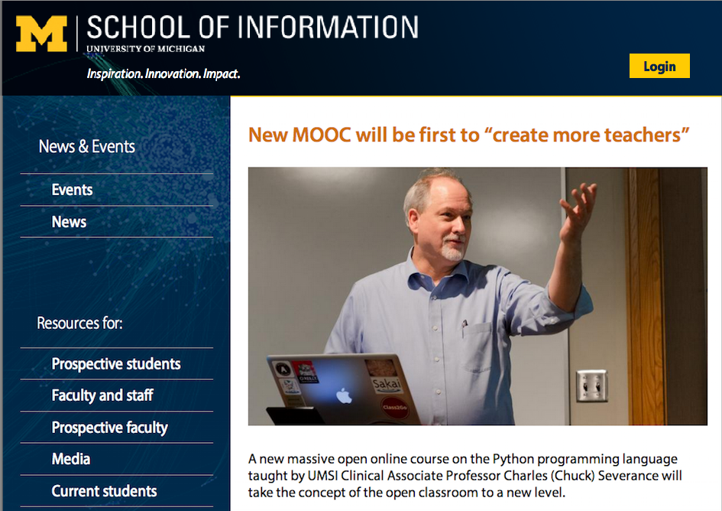
Professor (2007)
University of Michigan School Of Information
Liberal arts focus
Library school with tech focus
HCI with soft skills focus
I taught SI502 – Python for Librarians
It had to be simple
Students could not fail
Fine tuned for a number of years

Slide 10
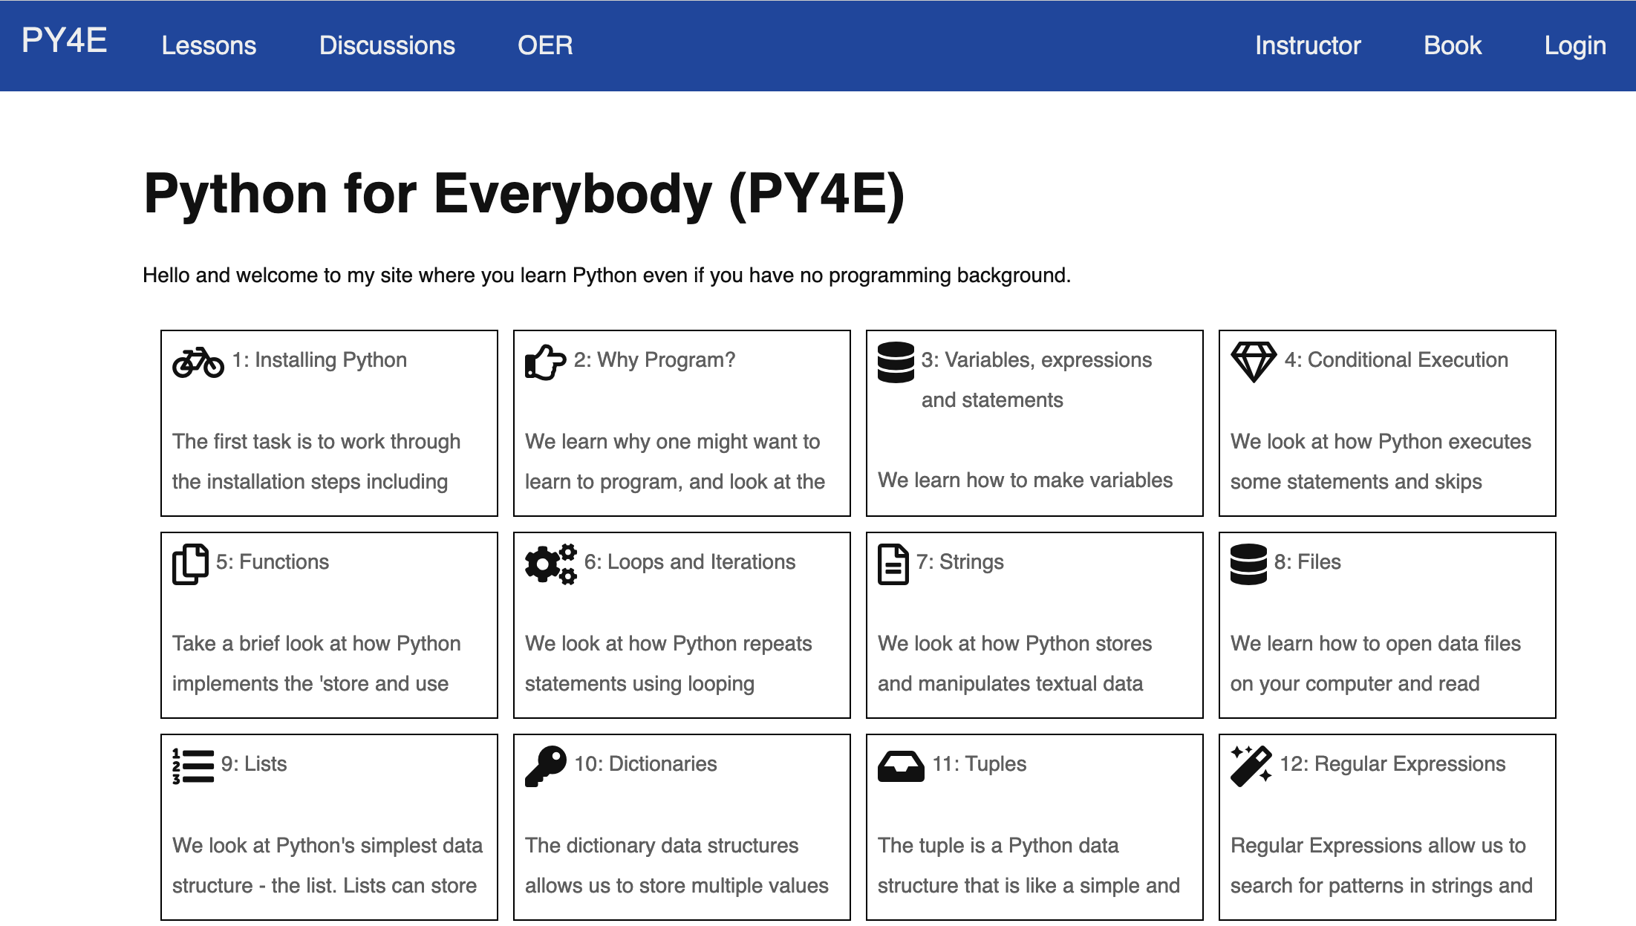
Tsugi (2010-)
PHP Based
Course Authoring Repository
Learning Tools Interoperability
Content Cartridge
Could be imported into an LMS
Sakai
Canvas
Imported into SI502 each semester

Slide 11

IHTS (2012)
Coursera founded in 2012
U Michigan was a founding partner
The only public university
Internet History, Technology, and Security was one of the "original six" from U Michigan
Built during the "secret phase" of Coursera
Based on two weeks of SI502 (Python)
Intended as an experiment to teach non-trivial technology to liberal arts students by moving slowly and building gradually

Slide 12
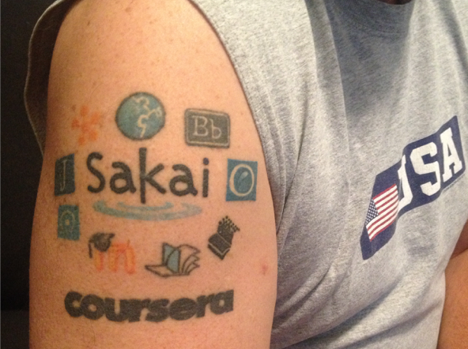
Coursera (2012)
If it only had Learning Tools Interoperability…
I could build a fully auto-graded course in a very short time
I helped code LTI 1.1 in Coursera
I became a publisher (like Pearson)
Coursera
edX
Canvas
Sakai
FutureLearn

Slide 13
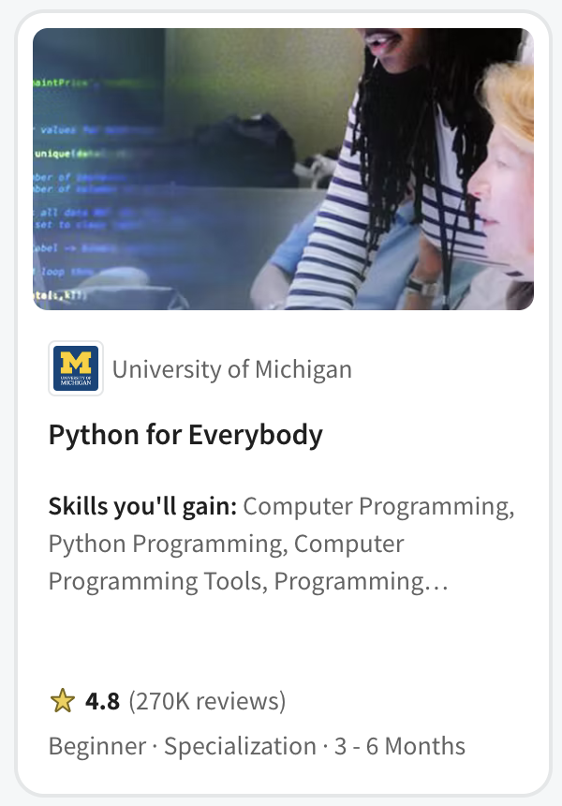
PY4E (2013)
Not a first course in Computer Science
Programing for Librarians
The rest of SI502
Quickly became the pre-requisite for
John Hopkins Data Science
Rice University Interactive Python
University of Michigan Applied Data Science with Python
University of Michigan Python 3
University of Michigan Statistics with Python
Popular in Coursera for Campus - India

Slide 14
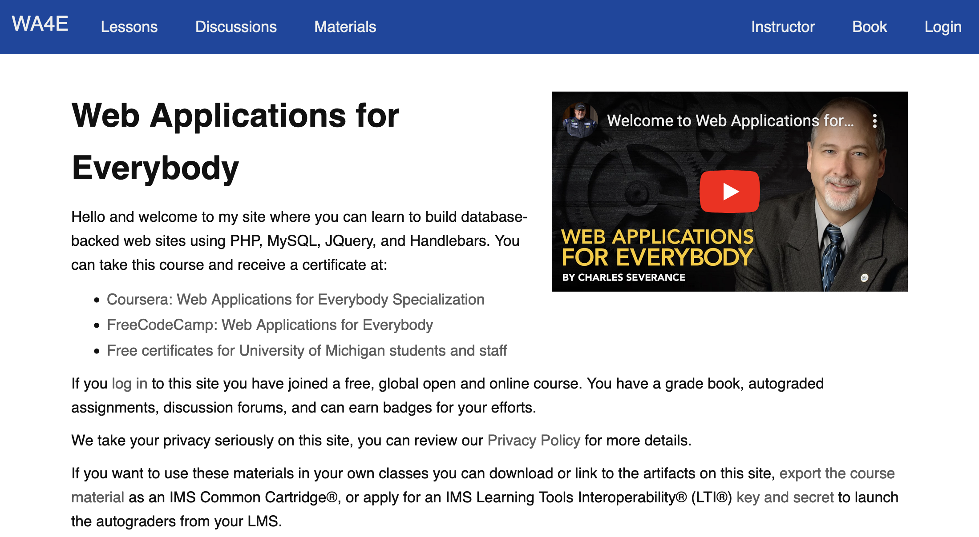
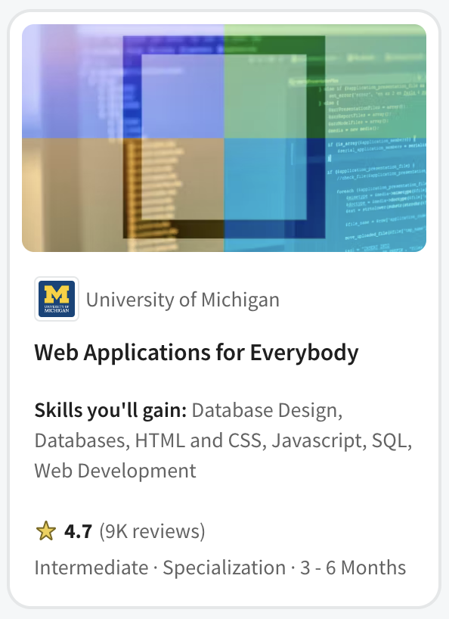
Web Applications for Everybody (2017)
PHP Course
On campus as SI572 / SI664 / SI364 (2012 – 2017)
Canvas, Coursera, edX, FutureLearn

Slide 15
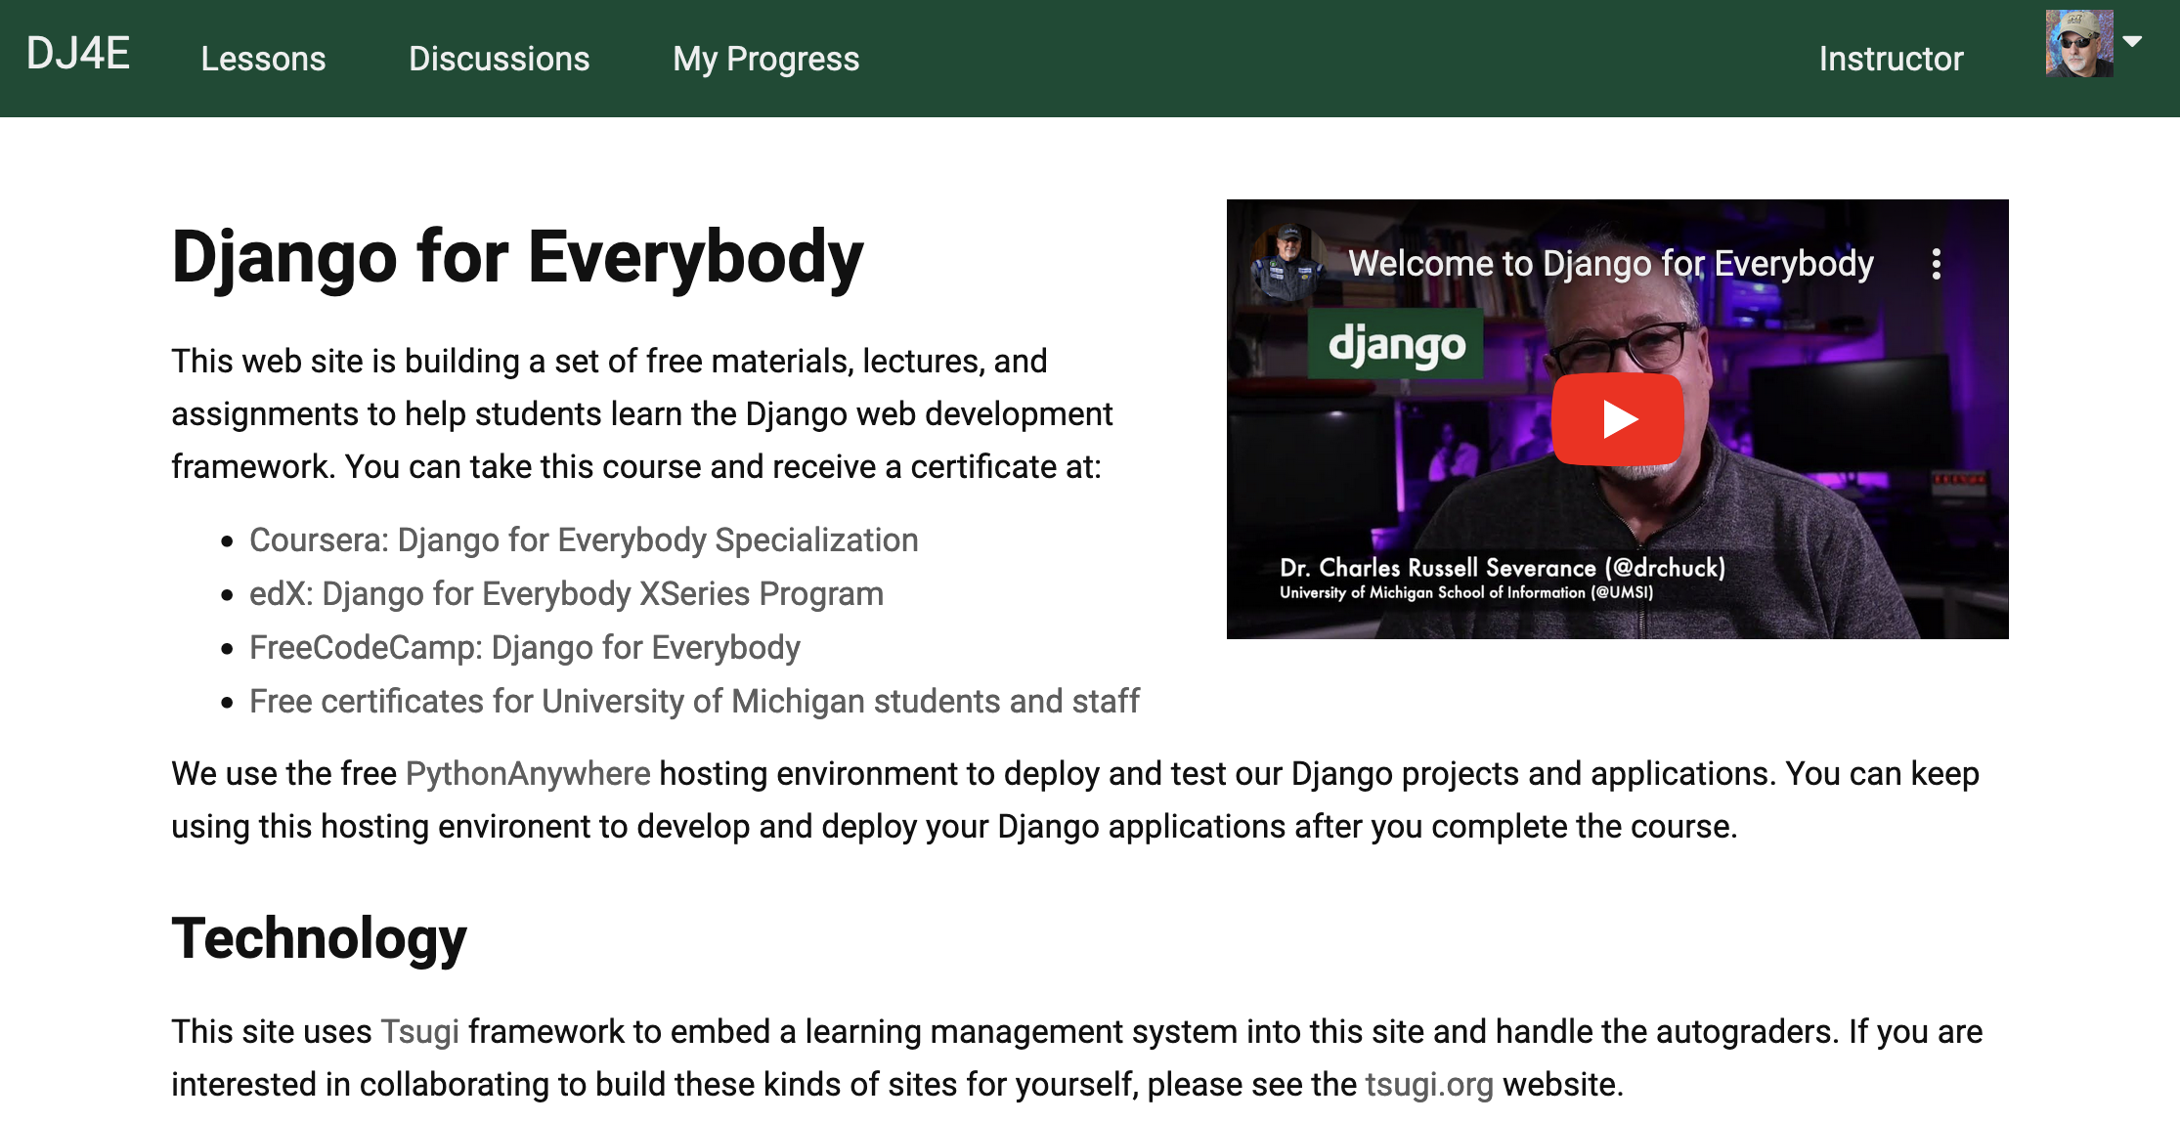
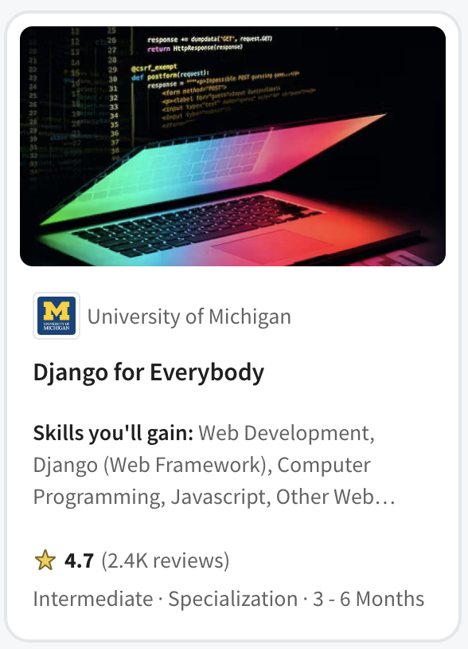
Django for Everybody (2020)
Curriculum committee said, "No more PHP!" (2016)
On campus SI664 / SI364 switched to Django
Canvas, Coursera, edX, FutureLearn

Slide 16
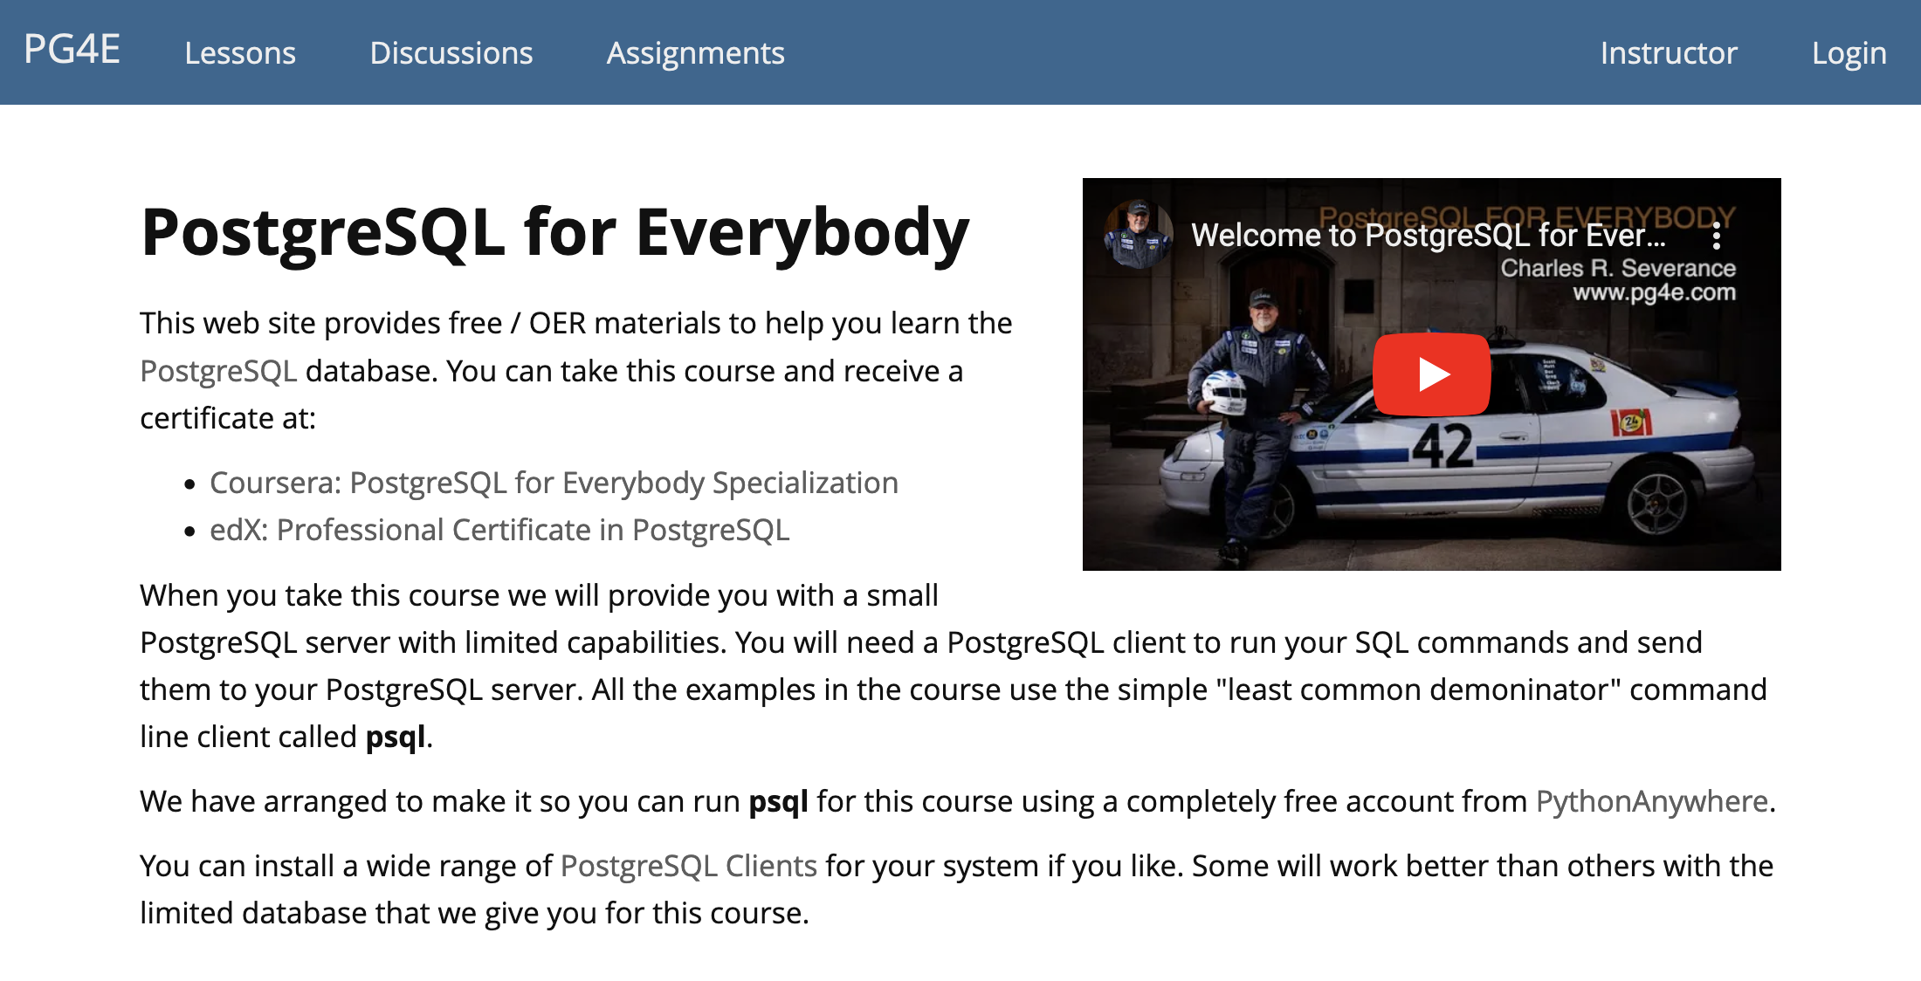
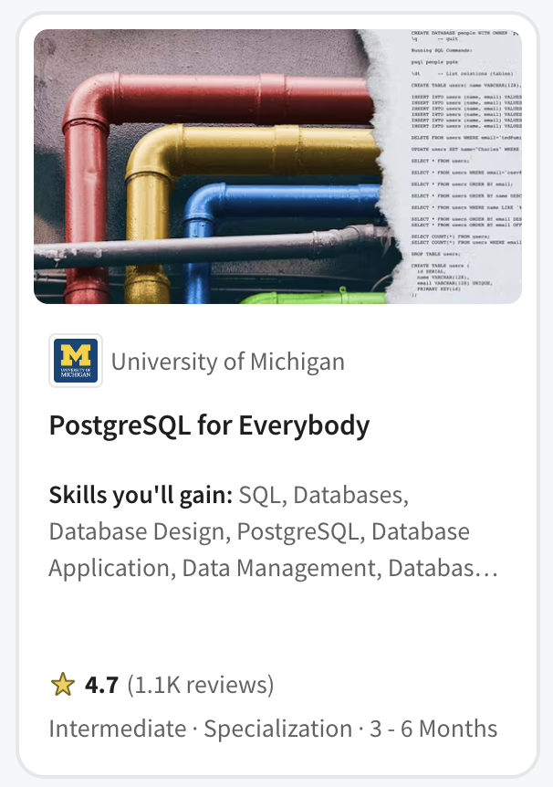
PostgreSQL for Everybody (2021)
Master of Applied Data Science on Coursera
SIADS 511 / 611
Coursera (MADS and Specialization)

Slide 17
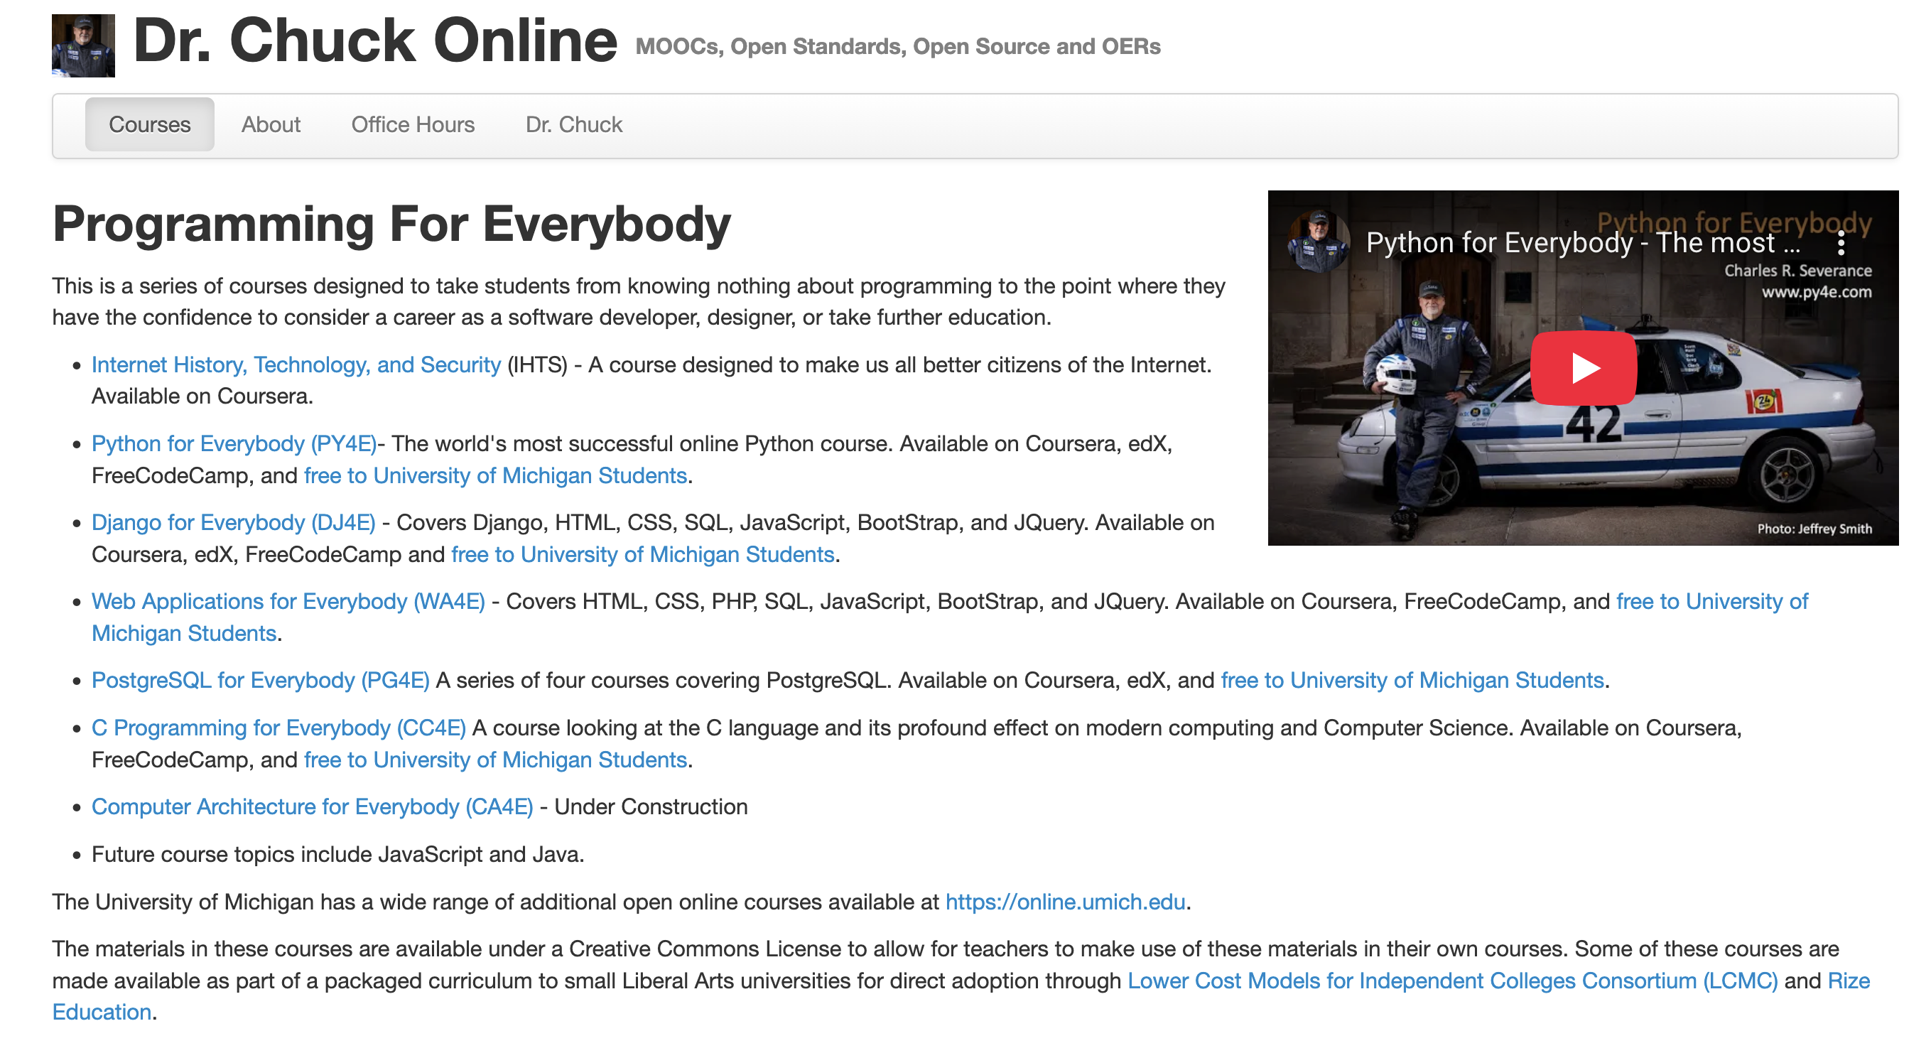

Slide 18
In Educational Technology for 25 years
The most popular programming course in the world
On Coursera
25 courses
Five specializations
A solid collection / curriculum
High school
Pre-Computer Science
Adult reskilling
Two year college
On the job training / skills Improvements
Ready to integrate into Canvas / Blackboard / Moodle / Desire2Learn

Slide 19
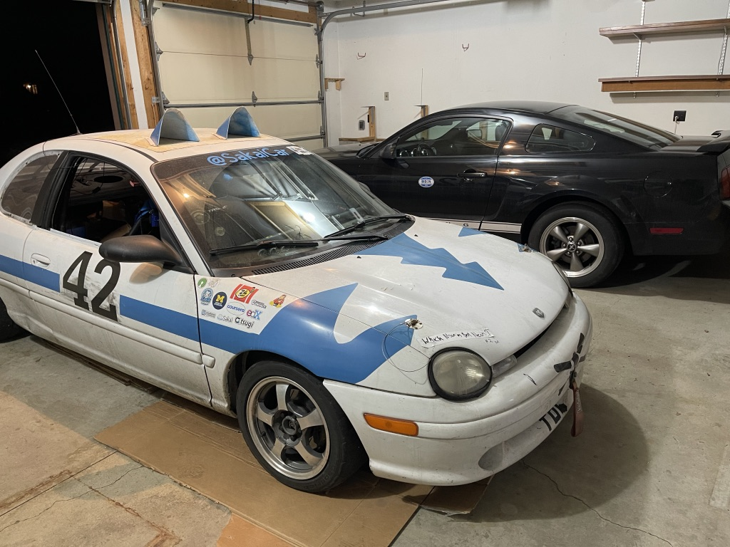

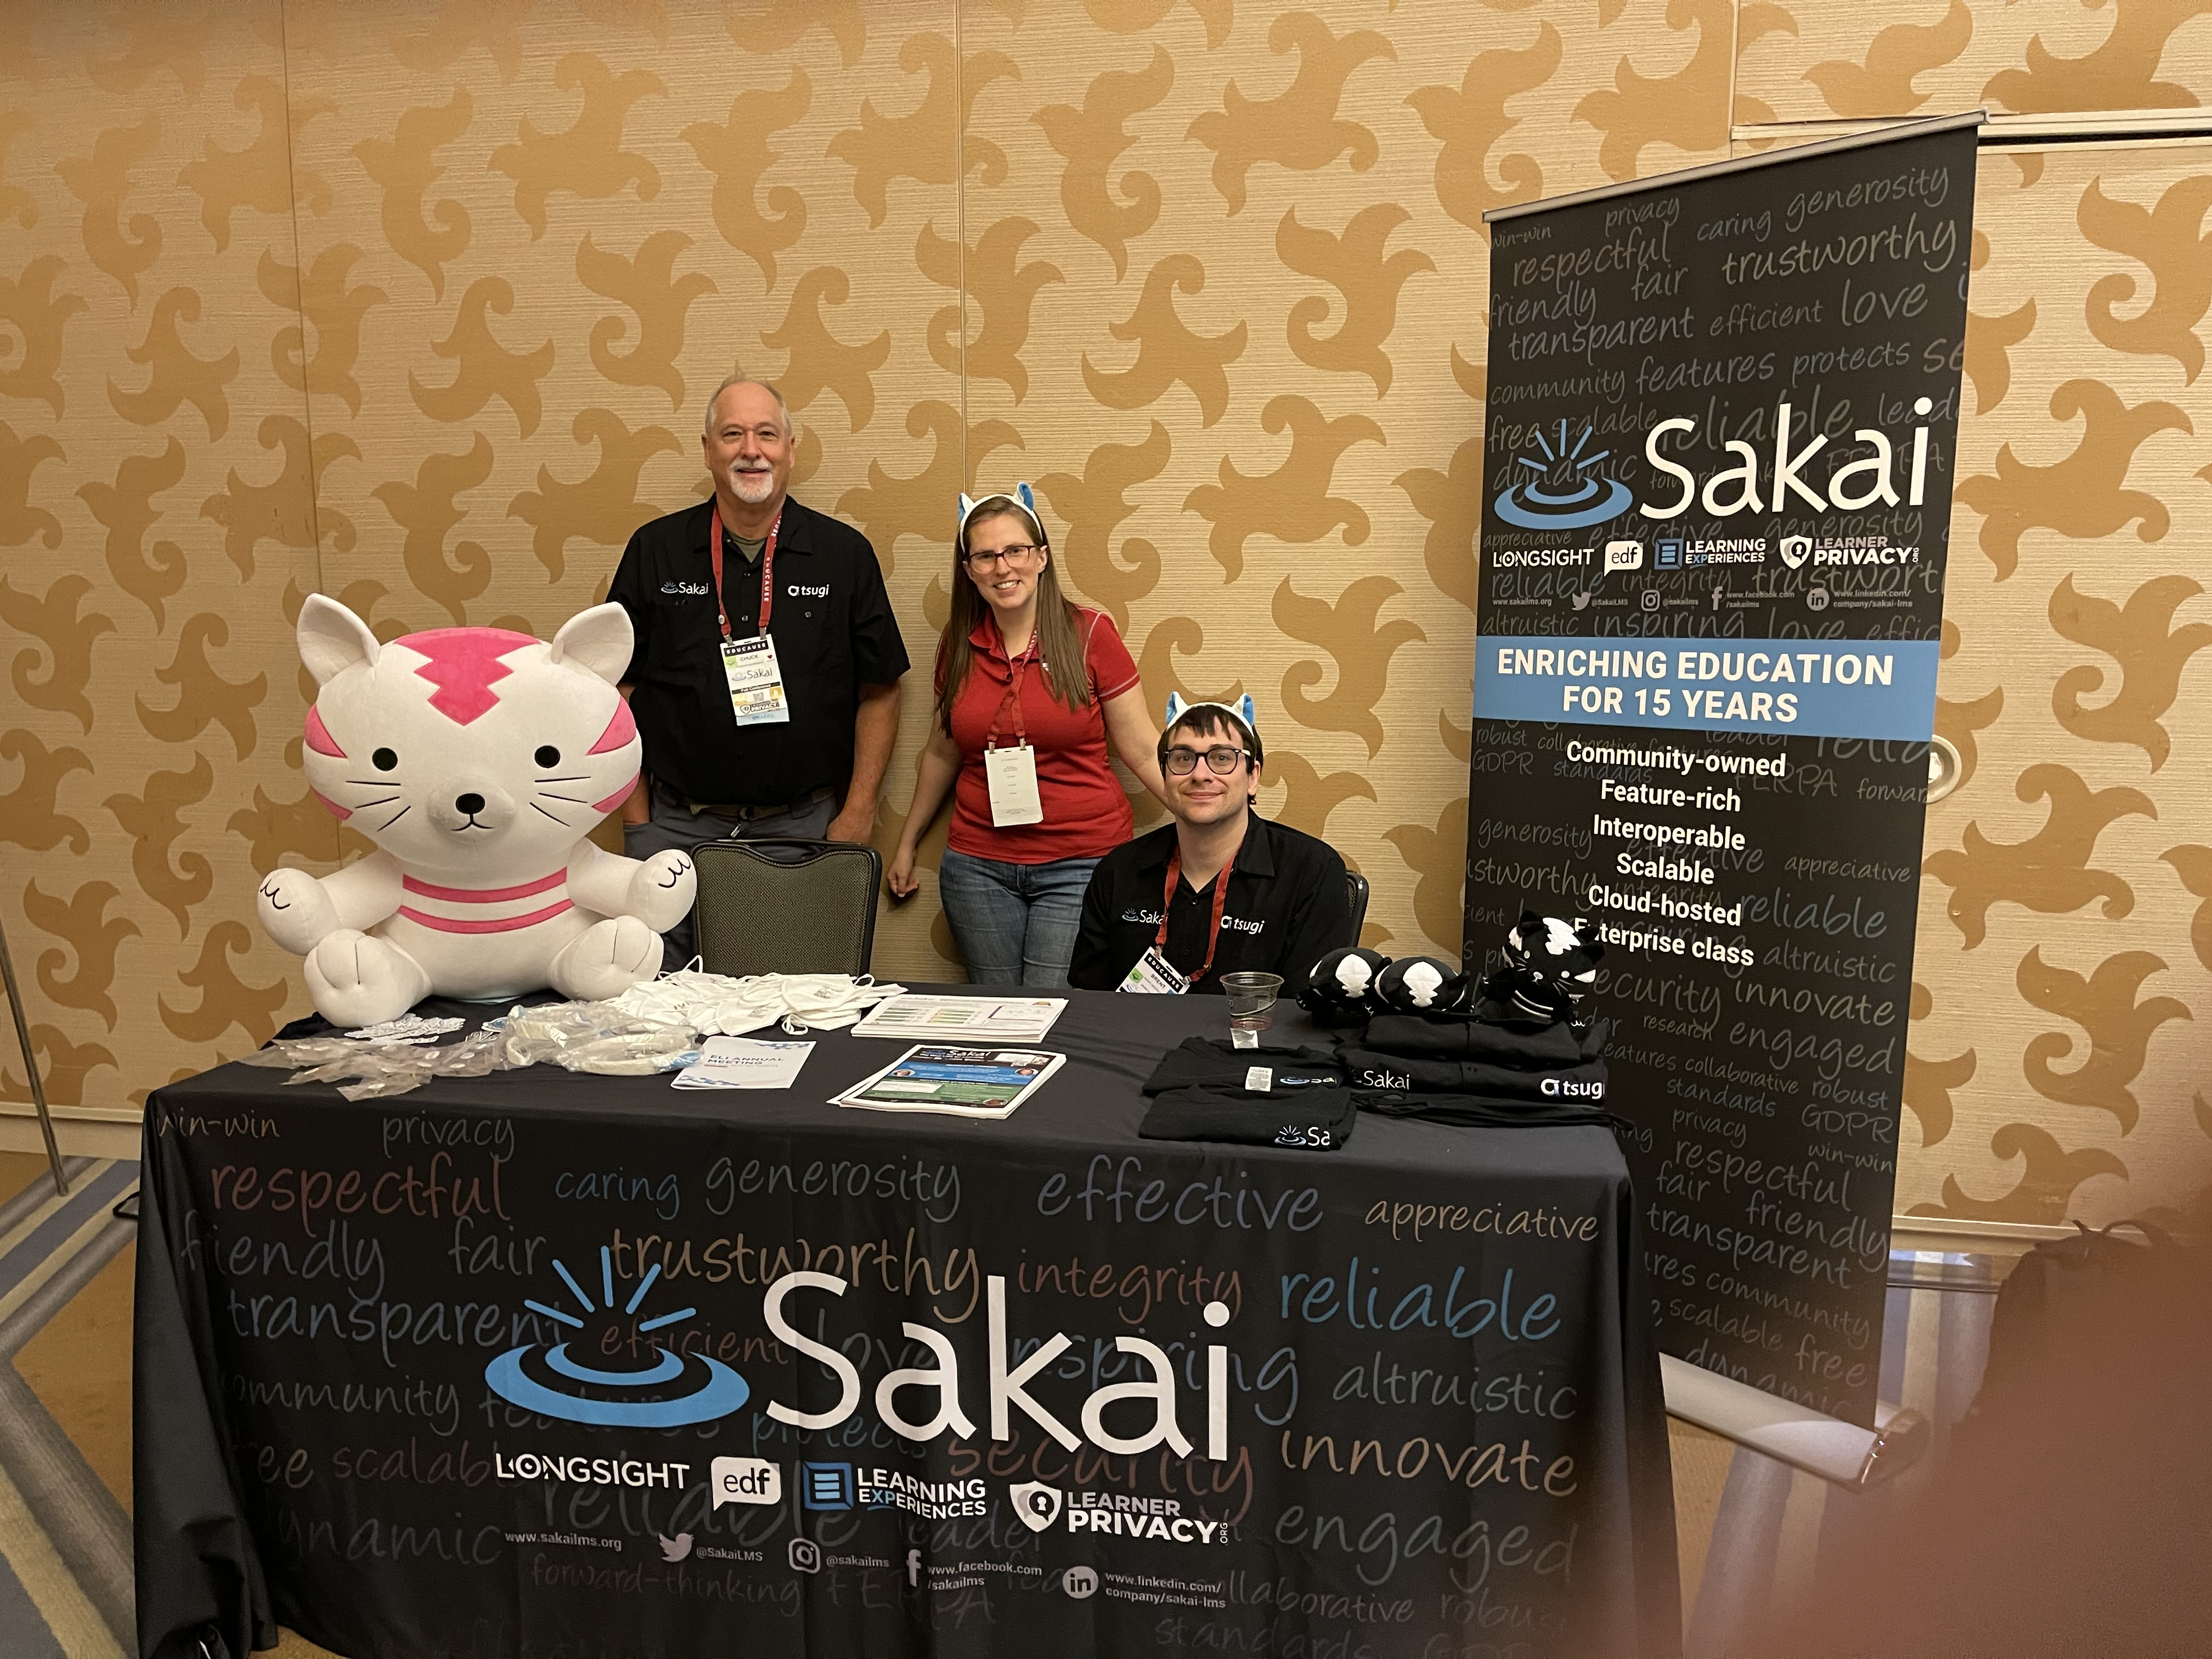
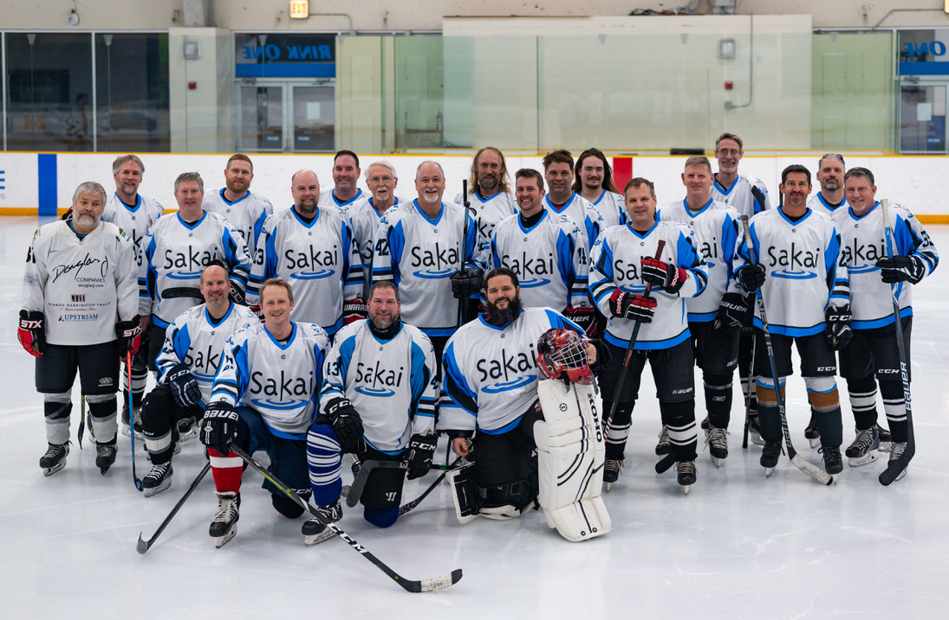

Should I slow down or even retire?
2022

Slide 20
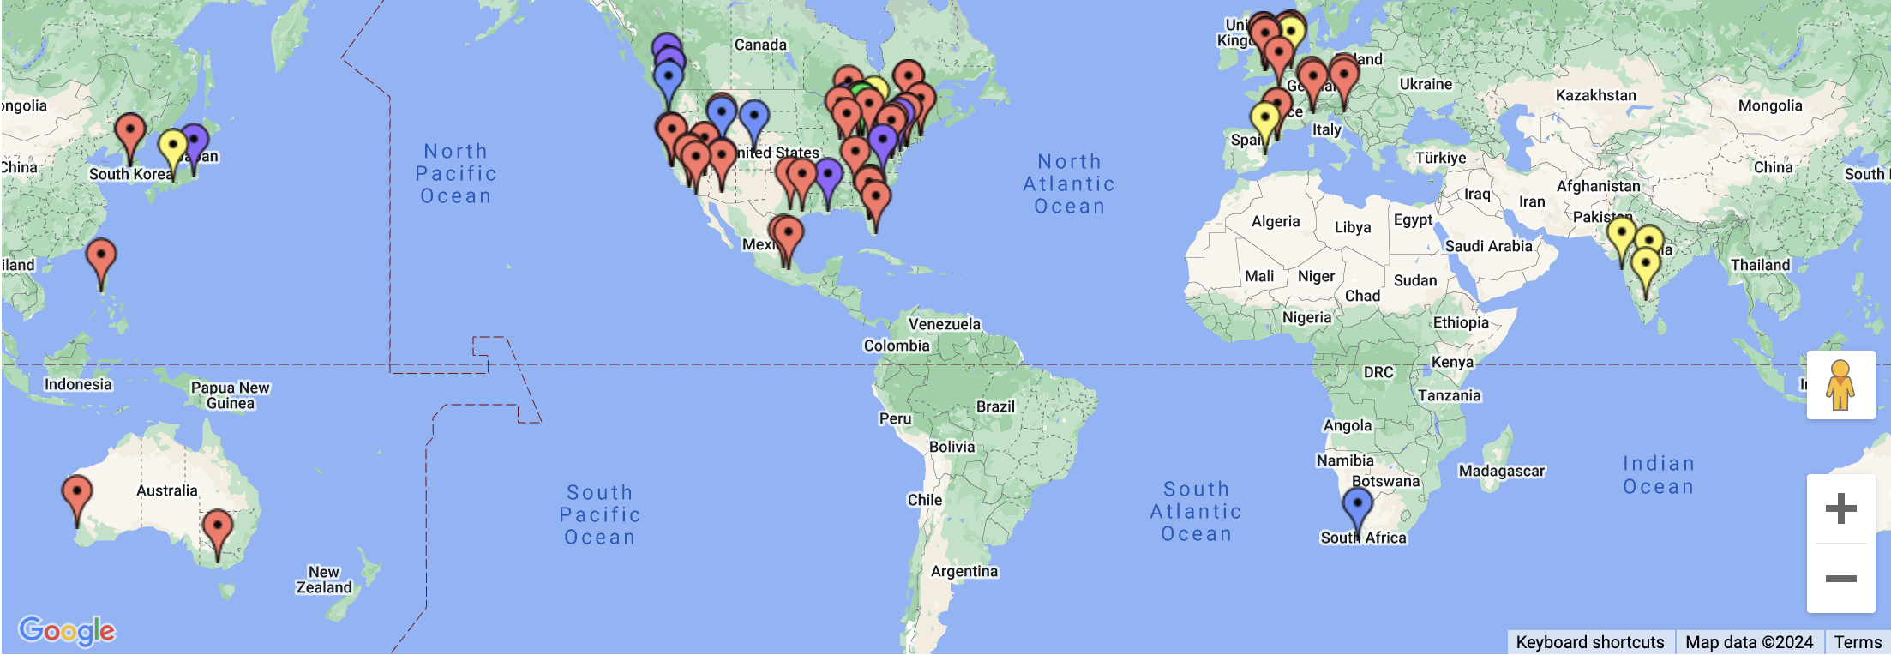
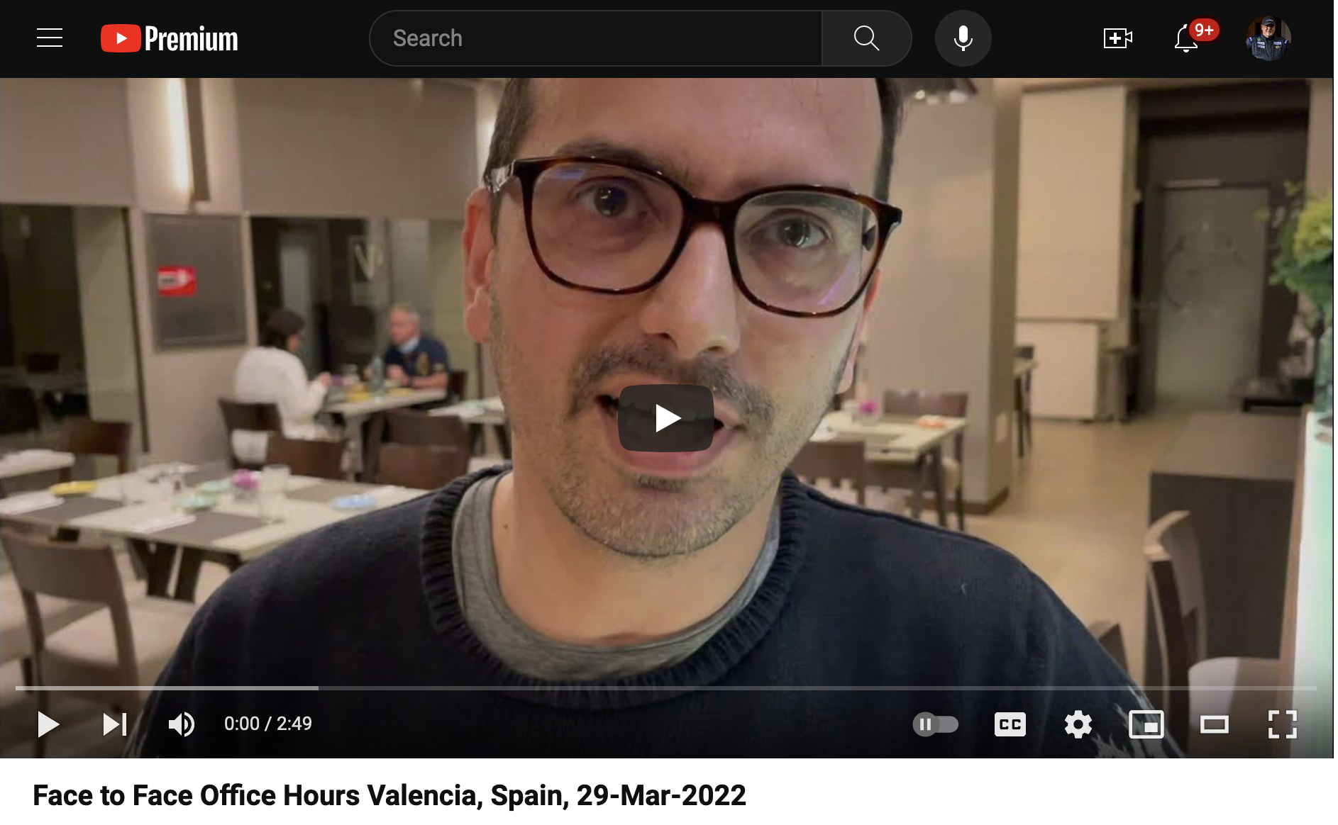
2022

Slide 21
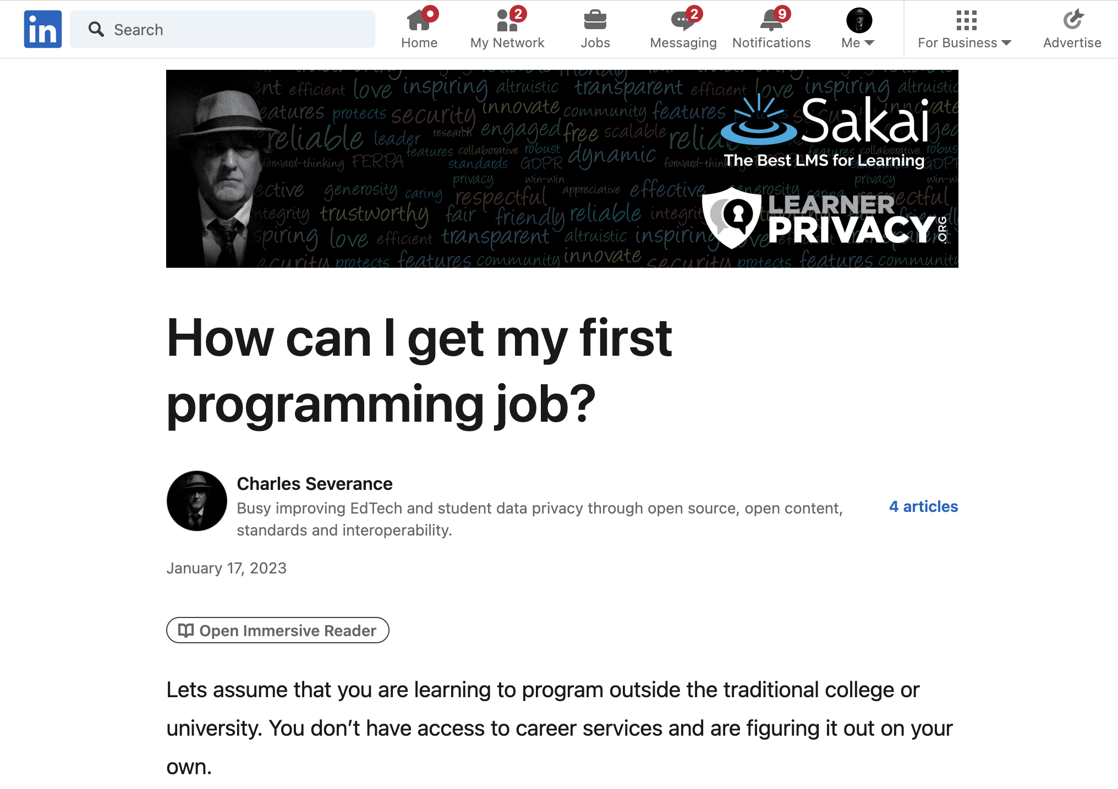

Slide 22

What kind of job can I get?

Slide 23
Would I hire the graduates of my "degree"?

Slide 24

If I would not hire my own graduates, what am I even doing?

Slide 25

A Brief Existential Crisis
Why am I here?
Have I let my students down?
Have I wasted their time?
Have I wasted my time?

Slide 26
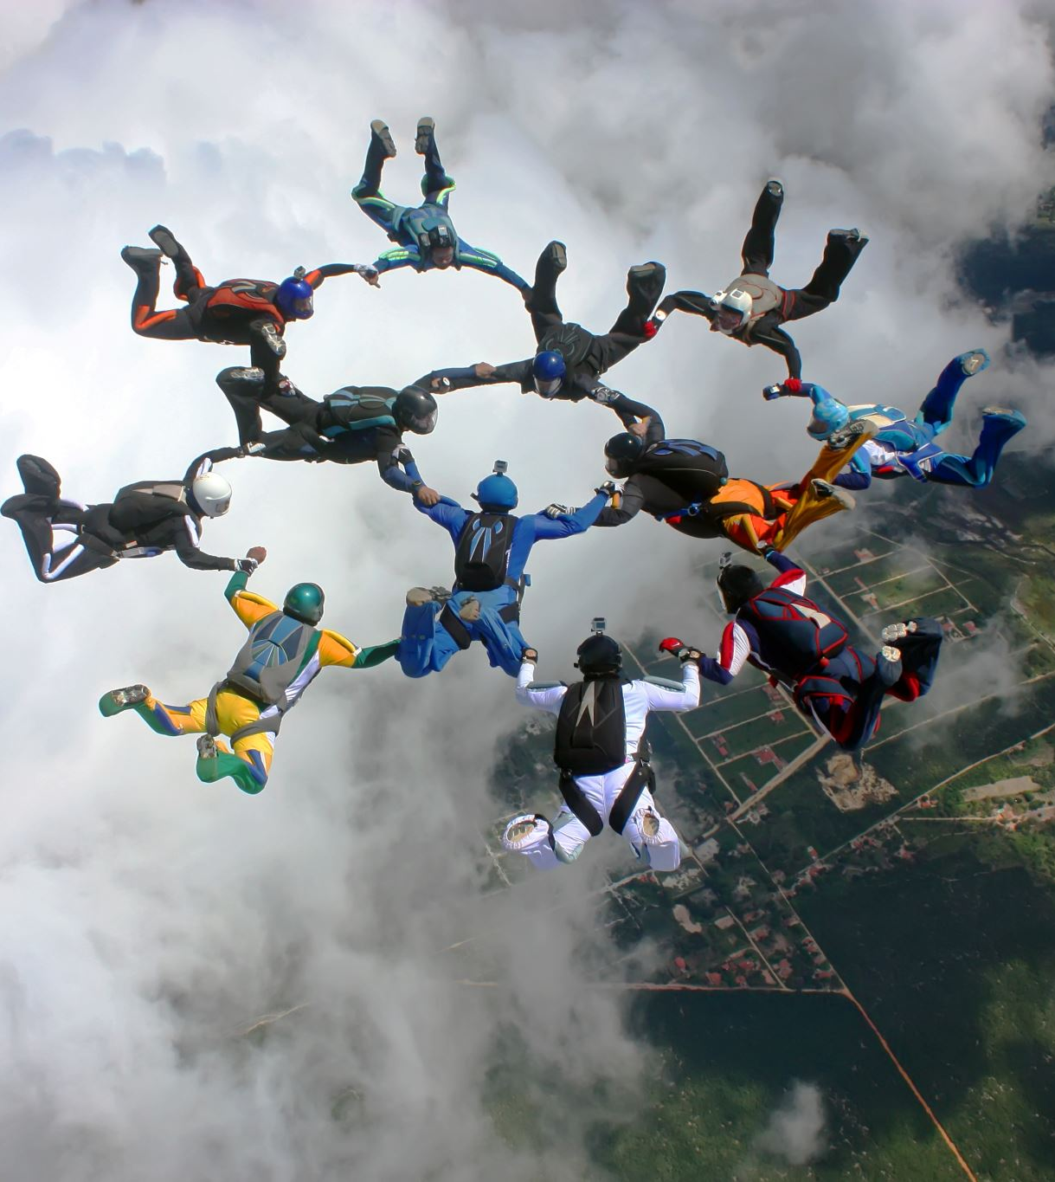
Who would I hire?
I have met so many amazing developers over the years
Almost no Computer Scientists
Self taught / learned from mentors
Practical experience in large real-world projects
Work to build other people – great mentors
Not wizards – but quick learners

Slide 27

My next thought..

Slide 28
Can I develop a series of courses to train the perfect programmer?

Slide 29
It is not what they know…
Flask
SpringMVC
RedShift
BigData
Rust
Java
C#
Scala
JavaScript
HTML
Go
C++
VB
Fortran
AI
Kotlin
Node
PHP
C
React
JQuery
Perl
Dart
Backbone
Angular
R
ObjectiveC
Svelte
Lua
Ruby
COBOL
Django
SQL
Assembly
Swift
Python
Jupyter

Slide 30
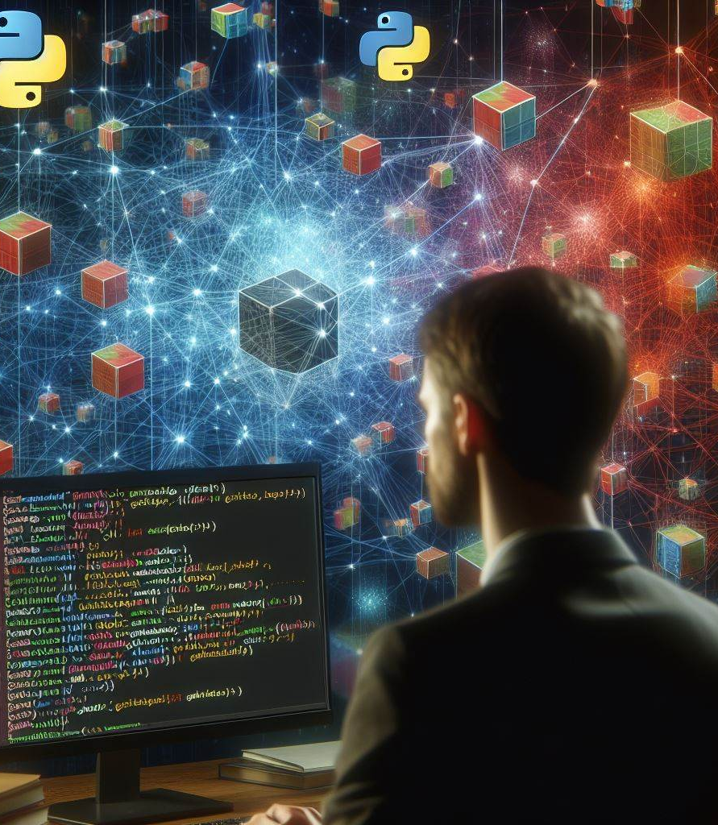
It is how they learn
Can learn any programming situation and master it in four weeks
See past the syntax (X-ray Vision)
Run-time environments and internal data structures memory use, performance tradeoff
Like a master electrician

Slide 31


Master Electrician

Slide 32
Flask
SpringMVC
Rust
RedShift
BigData
Java
C#
Scala
JavaScript
HTML
Go
C++
VB
Fortran
AI
Kotlin
PHP
Node
JQuery
Perl
C
React
Dart
Backbone
R
ObjectiveC
Angular
Svelte
Lit
Ruby
COBOL
Django
SQL
Assembly
Swift
Python
Jupyter

Slide 33
Flask
SpringMVC
RedShift
BigData
Rust
Java
C#
Scala
JavaScript
HTML
Go
C++
VB
Fortran
AI
Kotlin
Node
PHP
C
React
JQuery
Perl
Dart
Backbone
Angular
R
ObjectiveC
Svelte
Lit
Ruby
COBOL
Django
SQL
Assembly
Swift
Python
Jupyter
???
???
???
???

Slide 34
Flask
SpringMVC
RedShift
BigData
Rust
Java
C#
Scala
JavaScript
HTML
Go
C++
VB
Fortran
AI
Kotlin
Node
PHP
C
React
JQuery
Perl
Dart
Backbone
Angular
R
ObjectiveC
Svelte
Lit
Ruby
COBOL
Django
SQL
Assembly
Swift
Jupyter
Python
???
???
???

Slide 35
Flask
SpringMVC
RedShift
BigData
Rust
Java
C#
Scala
JavaScript
HTML
Go
C++
VB
Fortran
AI
Kotlin
Node
PHP
React
JQuery
Perl
Dart
Backbone
Angular
R
ObjectiveC
Svelte
Lit
Ruby
COBOL
Django
Swift
Jupyter
Python
C
Architecture
Assembly
SQL

Slide 36
Flask
Rust
SpringMVC
RedShift
BigData
Java
C#
Scala
HTML
JavaScript
Go
C++
VB
Fortran
AI
Kotlin
Node
PHP
Perl
React
JQuery
Dart
Backbone
R
ObjectiveC
Angular
Svelte
COBOL
Django
Lua
Ruby
Swift
Jupyter
???
???
???
Python
C
Architecture
Assembly
SQL

Slide 37
Flask
SpringMVC
BigData
Rust
RedShift
Java
Scala
C#
Fortran
Go
C++
VB
AI
Kotlin
PHP
React
Node
JQuery
Perl
Dart
Backbone
R
ObjectiveC
Angular
Svelte
Lua
Ruby
COBOL
Django
Swift
Jupyter
HTML
JavaScript
???
Python
C
Architecture
Assembly
SQL

Slide 38
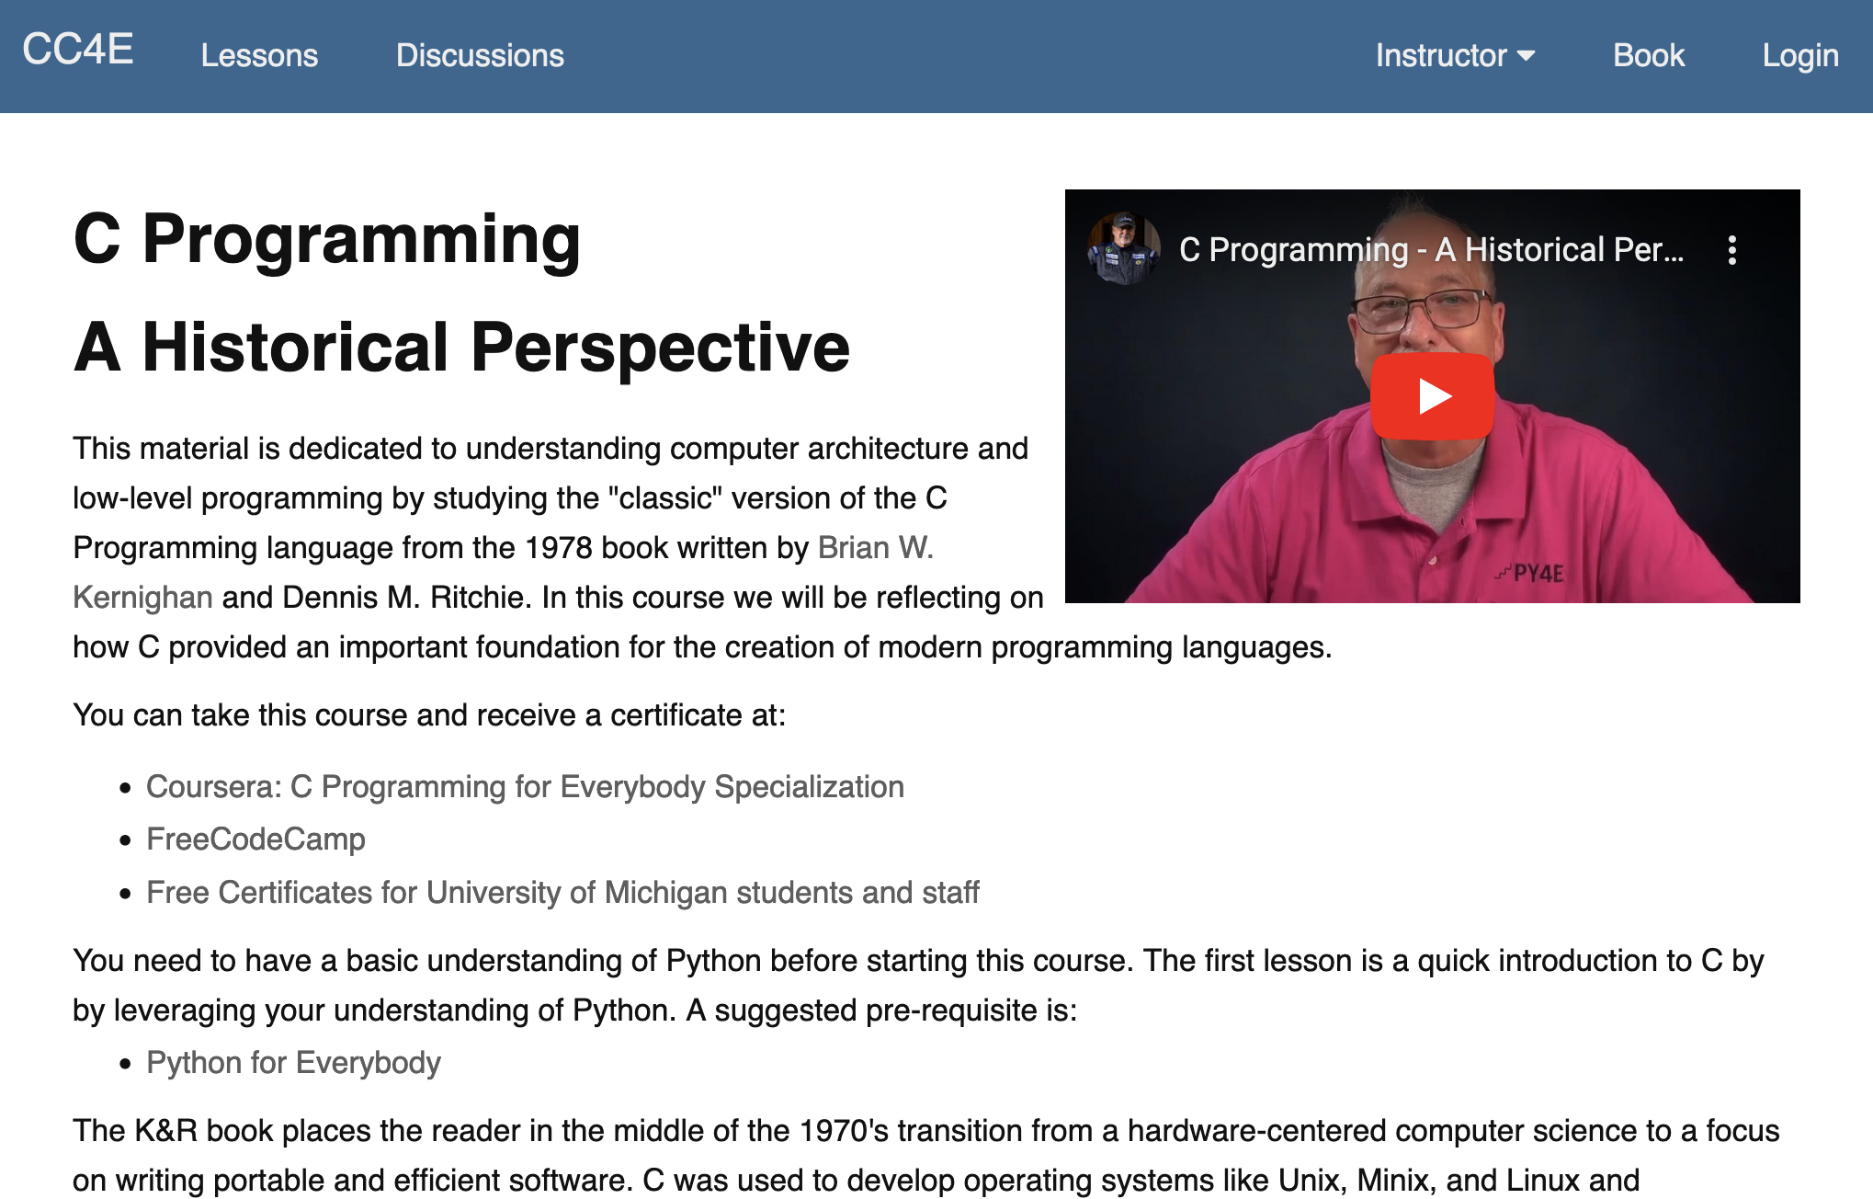
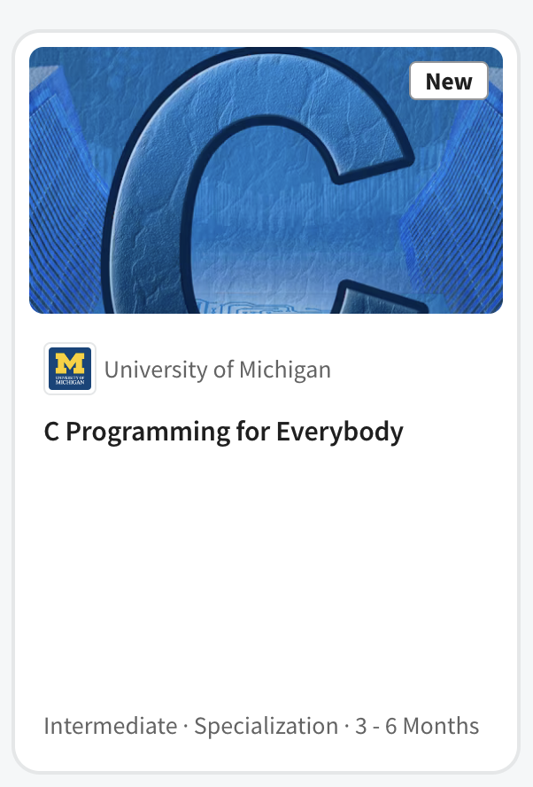
C Programming for Everybody (2023)
Based on the 1978 "C Programming" (45 years later)
Digitized, online, audiobook, accessible, annotated
Auto graders based on an in-browser C Compiler
Took 4 years to develop
Canvas, Coursera

Slide 39
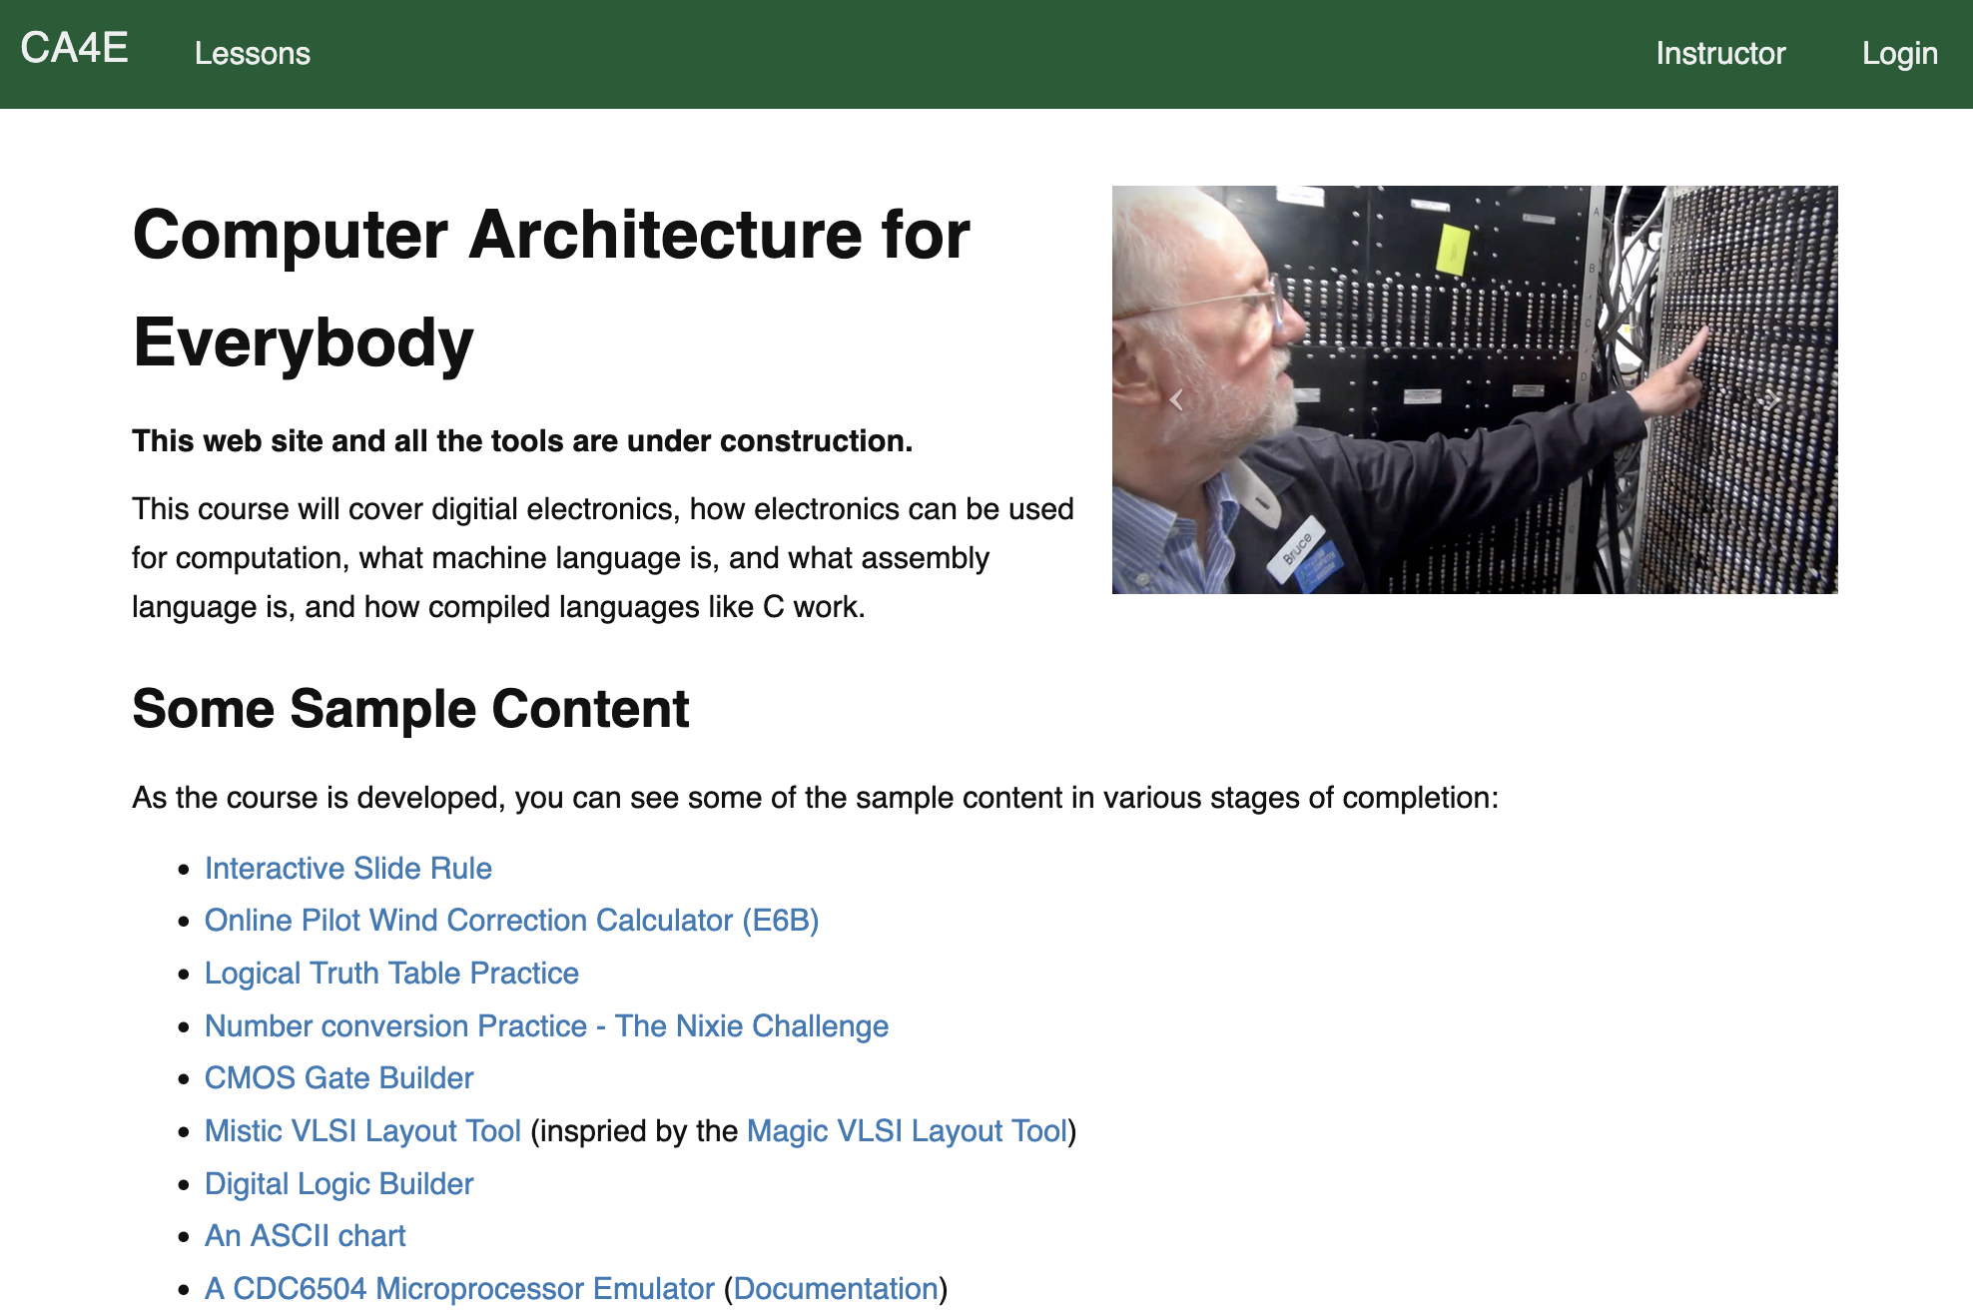
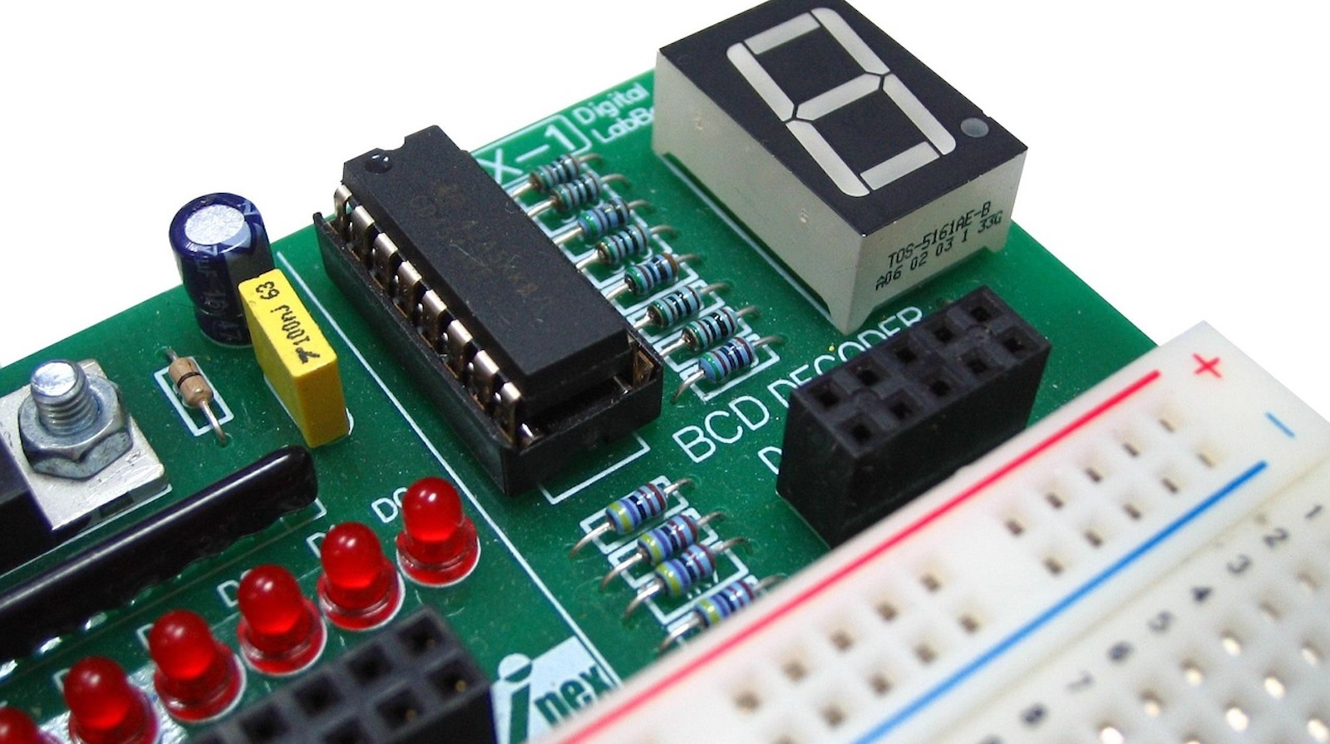
Computer Architecture for Everybody (2026)
Computer Architecture for Everybody
The fun, easy, and useful parts of computer hardware
Short fun lectures from Stonehenge to Microprocessors
Took 3 years to develop
Canvas, Coursera

Slide 40
The Path to the Master Programmer
JavaScript
Paid
Intern
ship
Hired!
???
Computer Architecture for Everybody

Slide 41
Looking Forward

Slide 42
Challenges for Higher Education
Post Graduation Job Market
We have too many programmer graduates expecting $120K right out of college
Downward pressure on salaries
Entry level jobs programming jobs are most vulnerable to AI
Challenges for Universities
Grant funding is dropping (support for graduate students)
International Student Visas
H1B Visas
Increasingly difficult to go to school full-time, go into debt, be away from the job market for five years, graduate and get a $90K job right out of college

Slide 43
My Idea – Sub-Degree-Non-Credit-Certificates
Bring the MOOC experience closer to the on-campus experience
Can be taken while working
Hybrid between Scheduled Cohort and/or Self Paced
Have regular access to UM-provided teaching staff
Scalable / Reasonable Cost / Profitable ➔ Best educational value
Online with F2F events at campus or at a destination
Week long intensive educational event – like a boot camp but with context
Graduation / Celebration
Treat these students like Alumni – long term relationship

Slide 44
Prototype Winter 2026 – www.ca4e.com
UMSI 311 / 040 – Computer Architecture for Everybody
Beta test course materials prior to putting it up on Coursera
For credit: 15 hand-picked undergraduate students
Guest cohort - synchronized – not for credit
3-4 Students from the "Saturdays in the D" program
5-10 Students from Coursera who have taken many of my courses
All will have access to regular Zoom rooms and all course communication
It is an experiment!!!

Slide 45
Hopes and Dreams
Semester long with 200 UMich Students on campus and 1500 worldwide non-credit students
Particular efforts to serve Michigan students – Recruiting and Funding
Technology to support one course prep for faculty and use one course staff across all students
UMSI could graduate 1000+ master programmers with UM certificates worldwide
Paid internships for Detroit and out-state Michigan students
Find a way to fund paid internships worldwide

Slide 46
High School??
CS1
APCS
Java
3 Cr (12)
CA4E Circuits/Gates
1.5 Cr (11)
WA4E
PHP / Web
3.0 Cr (10/11)
PG4E
Database
3.0 Cr (10/11)
CC4E
C / Alg / Data St
3 Cr (11)
WD4E (Part 2)
Design / Accessibility
1.5 Cr (9/10)
DJ4E
Web / Django /JS
3.0 Cr (9/10)
PY4E (Part 2)
Data Analysis
3 Cr (9/10)
WD4E (Part 1)
HTML/CSS
1.5 Cr (8/9)
PY4E (Part 1)
Programming
1.5 Cr (8/9)
Scratch/MindStorms/etc… 6/7/8

Slide 47
Thank you
Any questions?
Dr. Charles Severance
University of Michigan School of Information

